Slide 1


GENERIC COLLECTIONS
Notes:
Hello everyone. Welcome to Aitrich Academy. Today we are discussing about generic collections.

Slide 2







Generic collections are collections that are type-safe and can only hold objects of a specifictype.
They are defined in the System.Collections.Generic namespace and include the following classes:
List<T>
Dictionary<Tkey,TValue>
SortedList<TKey,TValue>
Stack<T>
Queue<T>
A dynamic-sized list that can hold objects of type T.
A collection of key/value pairs that maps keys of type TKey to values of type TValue.
A collection of key/value pairs that are sorted by the keys of type TKey.
A collection of objects that supports adding and removing objects in a LIFO (last-in, first-out) manner.
A collection of objects that supports adding and removing objects in a FIFO (first-in, first-out) manner.
Notes:
Imagine Generic Collections as containers that only allow specific types of things inside – it's like having different boxes for different kinds of objects. We want to make sure we're putting the right things in the right boxes.
These collections are type-safe, meaning they ensure that only objects of a specific type can go inside. We don't want to mix apples with oranges, right? That's where the type safety comes into play.
In C#, these Generic Collections are defined in the System.Collections.Generic namespace.
Let's look at a few of them:
List<T>: Think of it as a magical dynamic-sized list that can hold objects of a specific type (denoted by T).
Dictionary<TKey, TValue>: It's like a fancy organizer that pairs keys of a specific type (TKey) with values of another type (TValue).
SortedList<TKey, TValue>: Similar to a dictionary, but it keeps things sorted based on the keys.
Stack<T>: Picture a stack of books – last book you put on is the first one you grab. It works the same way for objects of a specific type (T).
Queue<T>: Now, think of standing in line – the first person in is the first person out. This is how a Queue works for objects of a specific type (T).
So, these Generic Collections are like special-purpose containers that ensure everything is organized and categorized, making it easy to work with different types of objects in a program.

Slide 3

LIST<T>
The List<T> in C# is a generic collection that represents a dynamic-sized list of objects of type T.
It is defined in the System.Collections.Generic namespace and provides a flexible way to store and manipulate collections of objects.
The List<T> class is the generic equivalent of the ArrayList class.
Notes:
List<T> :
Let's focus on one powerful and versatile collection in C# - the List<T>.
Think of a List<T> as a magical bag that can hold an ever-changing number of objects, all of the same type (denoted by T). It's like having a dynamic-sized list where you can add or remove items whenever you want.
This List<T> is part of the System.Collections.Generic namespace, ensuring type safety – only objects of type T can be part of this list. No mixing and matching of different types allowed!
It's incredibly flexible and provides various methods to manipulate and work with collections of objects. Whether you're adding, removing, or accessing items, the List<T> has got you covered.
Interestingly, the List<T> is the modern, generic equivalent of the older ArrayList class, offering better type safety and flexibility. It's like upgrading to a newer, more efficient version of a tool.
So, when you hear List<T>, think of it as a dynamic, type-safe list that adapts to your needs in the world of C# collections. It's a go-to choice for managing and working with collections of similar objects.

Slide 4

Some of the main features of List<T> include:
Dynamic sizing: The size of a List<T> can be modified at runtime, allowing you to add or remove items as needed.
Type safety: Since List<T> is a generic collection, it can only hold objects of type T, which provides type safety and prevents runtime errors.
Index-based access: Items in a List<T> can be accessed by their index, making it easy to retrieve and manipulate specific items in the list.
Built-in functionality : List<T> provides a range of methods for adding, removing, searching, and sorting items in the list.
Notes:
Some of the main features of List<T> include:
Dynamic Sizing: One of the coolest features is dynamic sizing. This means you can modify the size of a List<T> on the fly. Need to add or remove items? No problem – List<T> adjusts itself.
Type Safety: List<T> takes type safety seriously. Being a generic collection, it ensures that only objects of a specific type (T) can be part of the list. This not only makes your code cleaner but also prevents those tricky runtime errors.
Index-Based Access: Think of a List<T> like an array where each item has a number. You can easily access items by their index. It's like having a direct line to the item you want to work with.
Built-in Functionality: List<T> doesn't stop at just storing items. It comes with a range of built-in methods for adding, removing, searching, and sorting items. It's like having a toolkit that makes common operations a breeze.
These features make List<T> incredibly flexible and user-friendly. It adapts to your needs, ensures safety, and provides a set of tools to manipulate and manage collections effortlessly. Whether you're a beginner or a seasoned developer, List<T> is a go-to choice for handling dynamic lists in C#.

Slide 5
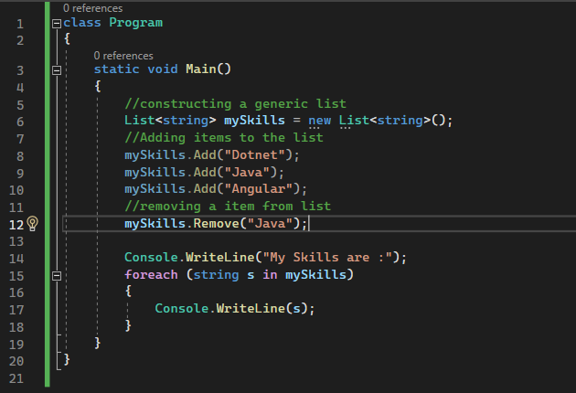
Example
Notes:
Example :
In this example, a List<string> named 'myskills' is employed to represent a dynamic-sized list of strings, specifically skills in this case. Various skills such as "Dotnet," "Java," and "Angular" are added to the list using the Add method. Following that, the Remove method is utilized to remove the skill "Java" from the list. The program then prints the message "The skills are:" to the console. Subsequently, a foreach loop is used to iterate through each string in the 'myskills' list, retrieving and printing each skill. This showcases the dynamic sizing and functionality of List<string>, allowing for the addition, removal, and display of skills in a straightforward manner. The expected output would be the remaining skills after the removal operation.

Slide 6
DICTIONARY<TKEY, TVALUE>
It is a generic collection that represents a collection of key/value pairs.
It is defined in the System.Collections.Generic namespace and provides a flexible way to store and manipulate collections of key/value pairs.​
Notes:
DICTIONARY<TKEY, TVALUE>
Let's shift our focus to another remarkable collection in C# - the Dictionary<TKey, TValue>.
Think of a Dictionary<TKey, TValue> as a magical book where you can associate keys (like chapter titles) with values (like page content). It's all about pairing information in a way that's easy to find.
This collection is part of the System.Collections.Generic namespace, ensuring type safety – only specific types for keys (TKey) and values (TValue) are allowed.
The Dictionary<TKey, TValue> is a flexible way to manage collections of key/value pairs. It's like having a super-organized library where you can quickly retrieve information based on specific keys.
So, when you hear Dictionary<TKey, TValue>, think of it as a powerful tool for associating and efficiently retrieving values based on specific keys. It's a go-to choice for scenarios where you want to look up information quickly and effectively in your C# programs.

Slide 7
Key/value pairs: A Dictionary<TKey, TValue> stores a collection of key/value pairs. Each key in the dictionary is unique.
Fast lookup: Because Dictionary<TKey, TValue> is implemented as a hash table, accessing an element in the dictionary by key is very fast.
Dynamic sizing: The size of a Dictionary<TKey, TValue> can be modified at runtime, allowing you to add or remove key/value pairs as needed.
Type safety: Since Dictionary<TKey, TValue> is a generic collection, it can only hold objects of type TKey for keys and TValue for values, which provides type safety and prevents runtime errors.
Notes:
Key Attributes of Dictionary<TKey, TValue> in C#
Key/Value Pairs: A Dictionary<TKey, TValue> is all about associations. It stores pairs of keys and values, creating a powerful way to organize and retrieve information.
Fast Lookup: Thanks to its implementation as a hash table, Dictionary<TKey, TValue> excels at speedy lookups. It's like having a super-fast index that allows you to access information almost instantly based on a specific key.
Dynamic Sizing: Just like our dynamic List, a Dictionary<TKey, TValue> can adjust its size at runtime. Whether you need to add or remove key/value pairs, the dictionary adapts seamlessly.
Type Safety: Being a generic collection, Dictionary<TKey, TValue> is strict about what it allows. Only objects of type TKey for keys and TValue for values are permitted. This not only keeps your data organized but also prevents those pesky runtime errors.
These attributes make Dictionary<TKey, TValue> a go-to choice when you need a fast, efficient, and organized way to store and retrieve key/value pairs in your C# programs. It's like having a high-speed, organized data vault at your disposal.

Slide 8

It provides methods such as
Add(TKey key, TValue value)
ContainsKey(TKey key),
ContainsValue(TValue value)
Remove(TKey key)
Clear()
Notes:
It provides methods such as Add(TKey key, TValue value), ContainsKey(TKey key),
ContainsValue(TValue value), Remove(TKey key) and Clear().

Slide 9
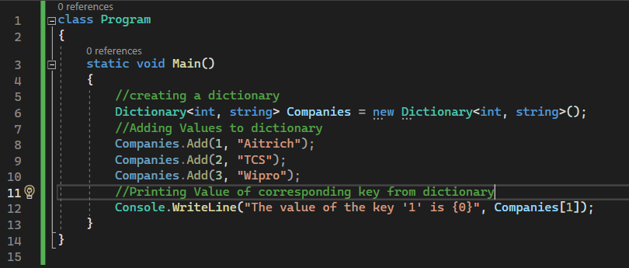
Example
Notes:
Example :
In this example, a Dictionary<int, string> named 'Companies' is utilized to represent a collection of key/value pairs, where integer keys are associated with corresponding company names. Various companies, including "Aitrich," "TCS," and "Wipro," are added to the dictionary using the Add method. The program then prints the value associated with the key '1' to the console using the index notation (Companies[1]). This showcases the dynamic sizing and fast lookup capabilities of Dictionary<int, string>, providing a convenient way to associate and efficiently retrieve values based on specific keys. The expected output would be "The value of the key '1' is Aitrich," demonstrating the ability to quickly access information in a dictionary by specifying the desired key.

Slide 10

SORTEDLIST<TKEY, TVALUE>
SortedList<TKey, TValue> is a generic collection that represents a collection of key/value pairs that are sorted by key.
It is defined in the System.Collections.Generic namespace and provides a way to store and manipulate collections of key/value pairs in a sorted order.
Notes:
SORTEDLIST<TKEY, TVALUE>
Let's now venture into another intriguing collection in C# - the SortedList<TKey, TValue>.
Picture this collection as a sophisticated organizer that not only stores key/value pairs but also keeps them in a neat, sorted order based on the keys. It's like having an automatically alphabetized address book for your data.
Like other generic collections, SortedList<TKey, TValue> resides in the System.Collections.Generic namespace, ensuring type safety. You get to define the types for both keys (TKey) and values (TValue).
The key feature here is sorting. The SortedList<TKey, TValue> is all about maintaining an ordered arrangement of key/value pairs, making it easy to locate specific information quickly.
So, when you encounter SortedList<TKey, TValue>, envision an organized, sorted collection that offers the benefits of both a dictionary and a sorted array. It's an excellent choice for scenarios where maintaining a specific order is crucial in your C# programs.

Slide 11
It provides methods such as
Add(TKey key, TValue value)
ContainsKey(TKey key),
ContainsValue(TValue value)
Remove(TKey key)
Clear()
Notes:
It provides methods such as Add(TKey key, TValue value), ContainsKey(TKey key),
ContainsValue(TValue value), Remove(TKey key), Clear().

Slide 12
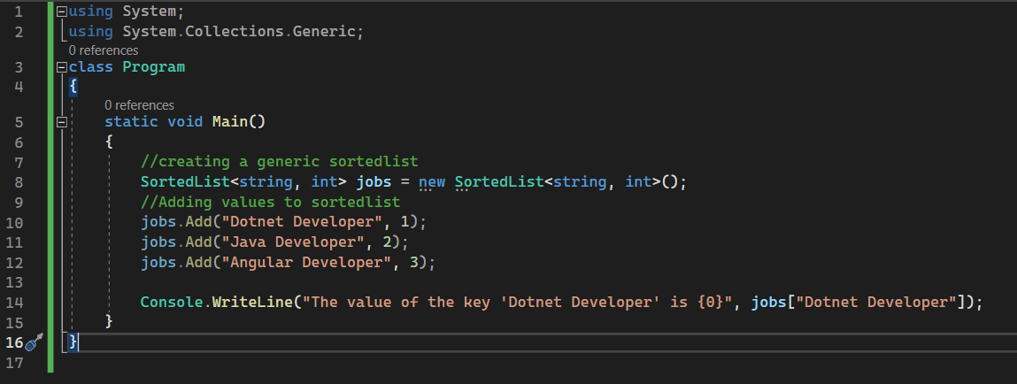
Example
Notes:
Example :
In this example, a SortedList<string, int> named 'jobs' is employed to represent a collection of key/value pairs, where string keys correspond to job titles, and integer values represent identifiers. Various job titles, including "Dotnet developer," "Java developer," and "Angular developer," are added to the sorted list using the Add method. The program then prints the value associated with the key 'Dotnet developer' to the console using the index notation (jobs["Dotnet developer"]). This showcases the SortedList<string, int>'s capability to maintain a sorted order based on keys, allowing for efficient retrieval of values associated with specific keys. The expected output would be "The value of the key 'Dotnet developer' is 1," demonstrating the SortedList's ability to provide organized and easily accessible information.

Slide 13

QUEUE<T>
Queue<T> is a generic collection in C# that represents a first-in, first-out (FIFO) data structure.
It is defined in the System.Collections.Generic namespace and provides a way to store and manipulate a collection of objects in the order in which they were added.
Notes:
QUEUE<T> :
Now, let's shift our focus to another fascinating collection in C# - the Queue<T>.
Imagine a Queue<T> as a digital waiting line, where the first person who joins is the first one to be served. It follows a "first-in, first-out" (FIFO) order, just like standing in line at your favorite coffee shop.
As a generic collection, Queue<T> is part of the System.Collections.Generic namespace, ensuring type safety. You get to define the type of objects it can hold (denoted by T).
The key feature here is the order of addition. Queue<T> provides a way to store and manipulate a collection of objects in the exact order they were added. It's like managing tasks or items in a structured, organized manner.
So, when you encounter Queue<T>, think of it as a smart digital line manager in your C# programs. It's an excellent choice when you want to ensure that tasks or items are processed in the order they arrive – first come, first served.

Slide 14
It provides methods such as
Enqueue
Dequeue,
Peek
Count.
Notes:
It provides methods such as Enqueue, Dequeue, Peek, Count.

Slide 15
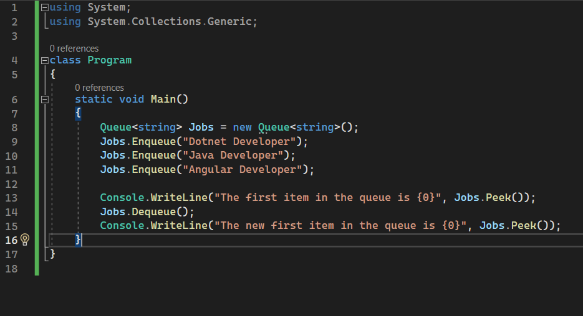
Example
Notes:
Example :
In this example, a Queue<string> named 'jobs' is utilized to represent a first-in, first-out (FIFO) collection of job titles. Various job titles, including "Dotnet developer," "Java developer," and "Angular developer," are added to the queue using the Enqueue method. The program then prints the message "The first item in the queue is {0}" followed by the result of peeking at the first item in the queue using the Peek method. Subsequently, the Dequeue method is employed to remove the first item from the queue. Finally, the program prints "The new first item in the queue is {0}" followed by the updated result of peeking at the first item in the modified queue. This showcases the FIFO nature of Queue<string>, ensuring that the first item added is the first one processed, and subsequent operations maintain the order of the queue. The expected output would display the initial and updated first items in the queue.

Slide 16

STACK<T>
Stack<T> is a generic collection that represents a last-in, first-out (LIFO) data structure.
It is defined in the System.Collections.Generic namespace and provides a way to store and manipulate a collection of objects in the specific datatype order in which they were added.
Notes:
STACK<T>
Now, let's delve into another intriguing collection in C# - the Stack<T>.
Picture a Stack<T> as a digital stack of books, where the last book you put on the stack is the first one you grab. It follows a "last-in, first-out" (LIFO) order, much like stacking plates or books.
As a generic collection, Stack<T> is part of the System.Collections.Generic namespace, ensuring type safety. You get to define the type of objects it can hold (denoted by T).
The key feature here is the order of addition – the last item added is the first one processed. It's like managing a pile of tasks or items in a structured, organized manner.
So, when you encounter Stack<T>, envision a smart digital stack manager in your C# programs. It's an excellent choice when you want to ensure that tasks or items are processed in the reverse order they were added – the latest addition gets attention first.

Slide 17
It provides methods such as
Push
Pop
Peek
Count.
Contains
Notes:
It provides methods such as Push , Pop, Peek ,Count and Contains

Slide 18
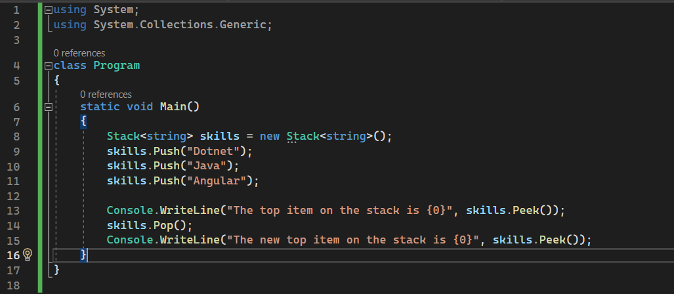
Example
Notes:
Example:
In this example, a Stack<string> named 'skills' is utilized to represent a last-in, first-out (LIFO) collection of skill names. Various skills, including "Dotnet," "Java," and "Angular," are added to the stack using the Push method. The program then prints the message "The top item on the stack is {0}" followed by the result of peeking at the top item in the stack using the Peek method. Subsequently, the Pop method is employed to remove the top item from the stack. Finally, the program prints "The new top item on the stack is {0}" followed by the updated result of peeking at the new top item in the modified stack. This showcases the LIFO nature of Stack<string>, ensuring that the last item added is the first one processed, and subsequent operations maintain the order of the stack. The expected output would display the initial and updated top items in the stack.

Slide 19
LINQ-Language Integrated Query
It is a powerful feature in C# that provides a unified way to query and manipulate data from different data sources. It allows you to write queries against collections, databases, XML documents, and other data sources using a consistent syntax.
LINQ introduces a set of standard query operators that can be used with any data source that implements the IEnumerable<T> interface. These operators are defined as extension methods in the System.Linq namespace.
Notes:
LINQ-Language Integrated Query :
Now, let's uncover a powerful tool in C# called LINQ, which stands for Language Integrated Query. Don't let the technical name intimidate you; it's like having a super-smart way to ask questions and get information from various sources.
Imagine you have different data sources like lists of items, databases, or even XML documents. LINQ provides a universal language to query and manipulate data from these sources. It's like having a magic wand that lets you ask questions and get answers, no matter where the data comes from.
What makes LINQ special is its consistent syntax. Whether you're querying a list of names or pulling information from a database, the way you write your queries remains the same. It's like having a universal language for data exploration.
LINQ comes with a set of standard query operators – think of them as special tools. These operators work with any data source that implements the IEnumerable<T> interface. Now, that might sound technical, but it just means it can work with various types of data.
And where does LINQ live? It's all defined in the System.Linq namespace. So, when you hear LINQ, think of it as your friendly guide to asking questions and getting insights from different data sources, all using a consistent and easy-to-understand language.

Slide 20
LINQ - Example
^{static void Main()}
^{{/ Create a list of integers}
List<string> memberList = new List<string> {"JobSeeker","admin","JobProvider"};// Query the list using LINQ
var allMembers = from member in memberList
select member;// Iterate over the query results
foreach (var member in allMembers)
{
^{Console.WriteLine(member);}
}
^{Console.ReadLine();}
}
Notes:
Example :
In this example, a program is created with a list of strings representing different roles such as "JobSeeker," "admin," and "JobProvider." The power of LINQ is harnessed to query this list using a concise and readable syntax. The query, specified with the 'from' and 'select' keywords, retrieves all members from the 'memberList.' The results are then iterated using a foreach loop, and each member is printed to the console. This showcases the simplicity and elegance of LINQ, enabling easy data querying and manipulation. In this example, it efficiently extracts and displays the roles in the list, demonstrating how LINQ provides a unified and expressive way to interact with data in C# programs. The Console.ReadLine() at the end ensures the console window remains open for result visibility.

Slide 21

Notes:
Thank you for joining this session.

